Slide 1
How to go from Black and White to Color in PowerPoint: COOL EFFECT!
www.brainybetty.com

Slide 2
Goal of this tutorial:
You will learn in a few minutes and even fewer steps how to achieve a really cool photo effect in PowerPoint – animating a black and white photo or clipart and “morphing” it into color.

Slide 3


Example 1: Clipart

Slide 4


Example 2: Photo

Slide 5
Here’s how it’s done…
Take a blank slide.
Put a photo or clipart on it.
Copy the photo and place it directly on top of the initial picture.
Click the top photo and highlight it.
Color.
Animate.

Slide 6
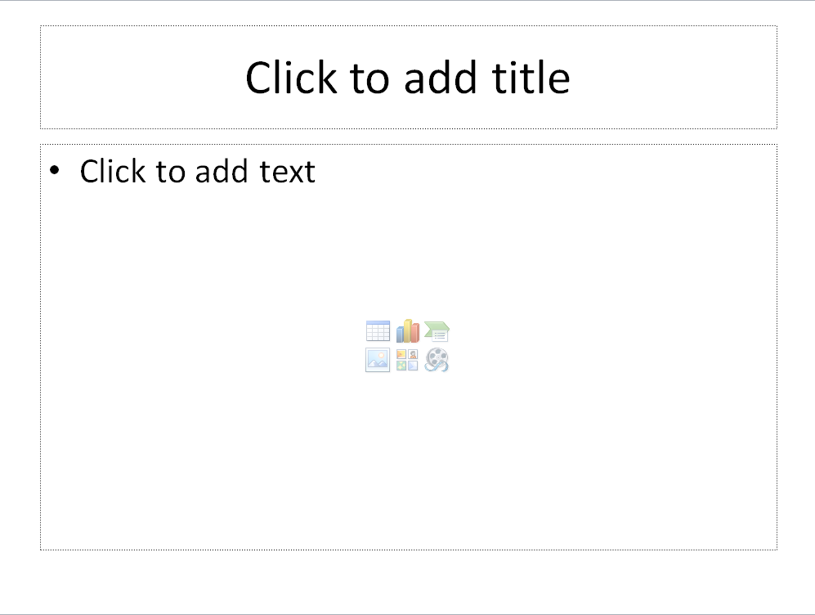
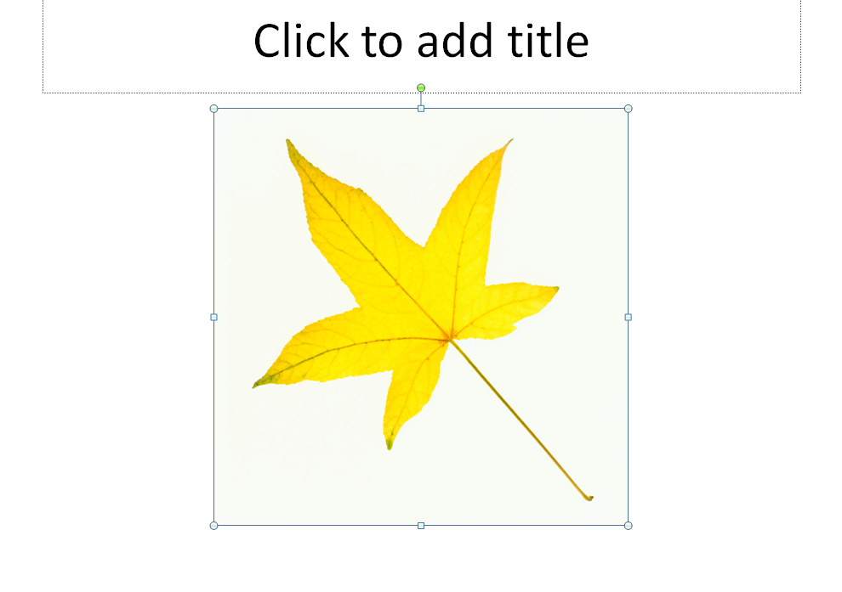
Blank slide: Put a picture on it.

Slide 7
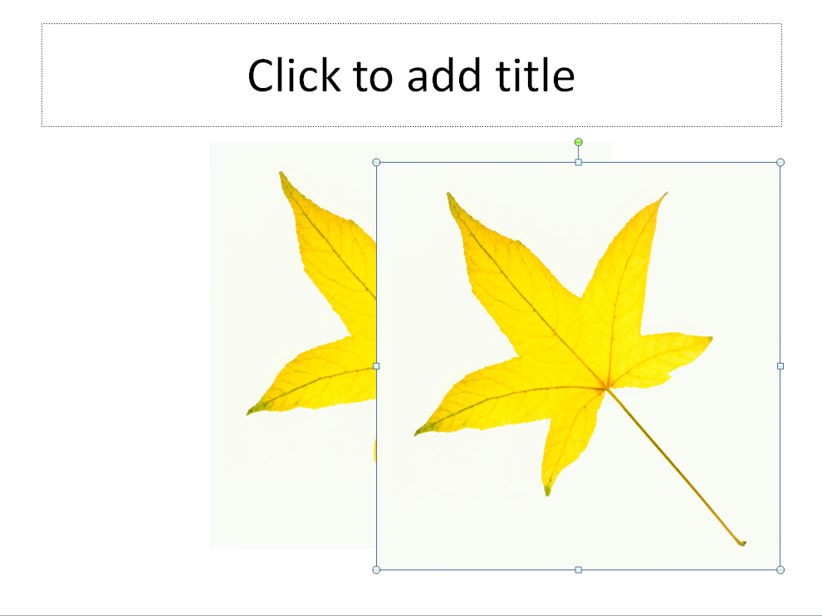
Copy picture and paste directly underneath the first.

Slide 8


Click on the top picture and Recolor.
Format Tab>>Color Menu

Slide 9
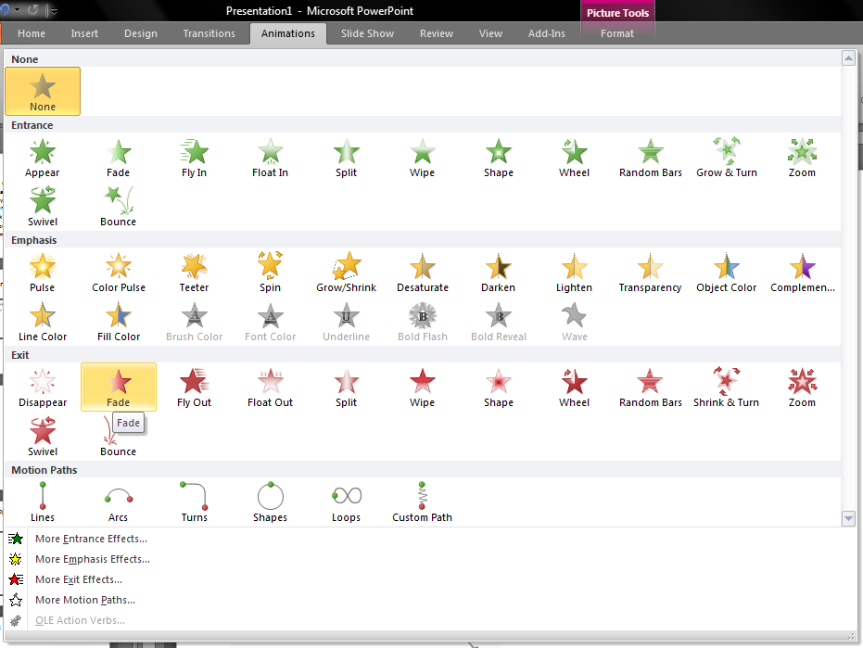

Animate the top picture:
Exit Effect: Fade

Slide 10
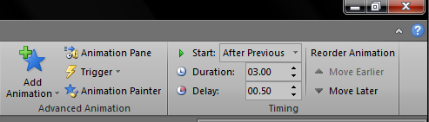
Change animation timings thus:
Start: AFTER PREVIOUS FOR AUTOMATIC ANIMATION
Duration: 3.00 seconds or more
Delay: About a second or more

Slide 11


Try it out! It’s easy and an awesome effect!

Slide 12
www.brainybetty.com

